Slide 1
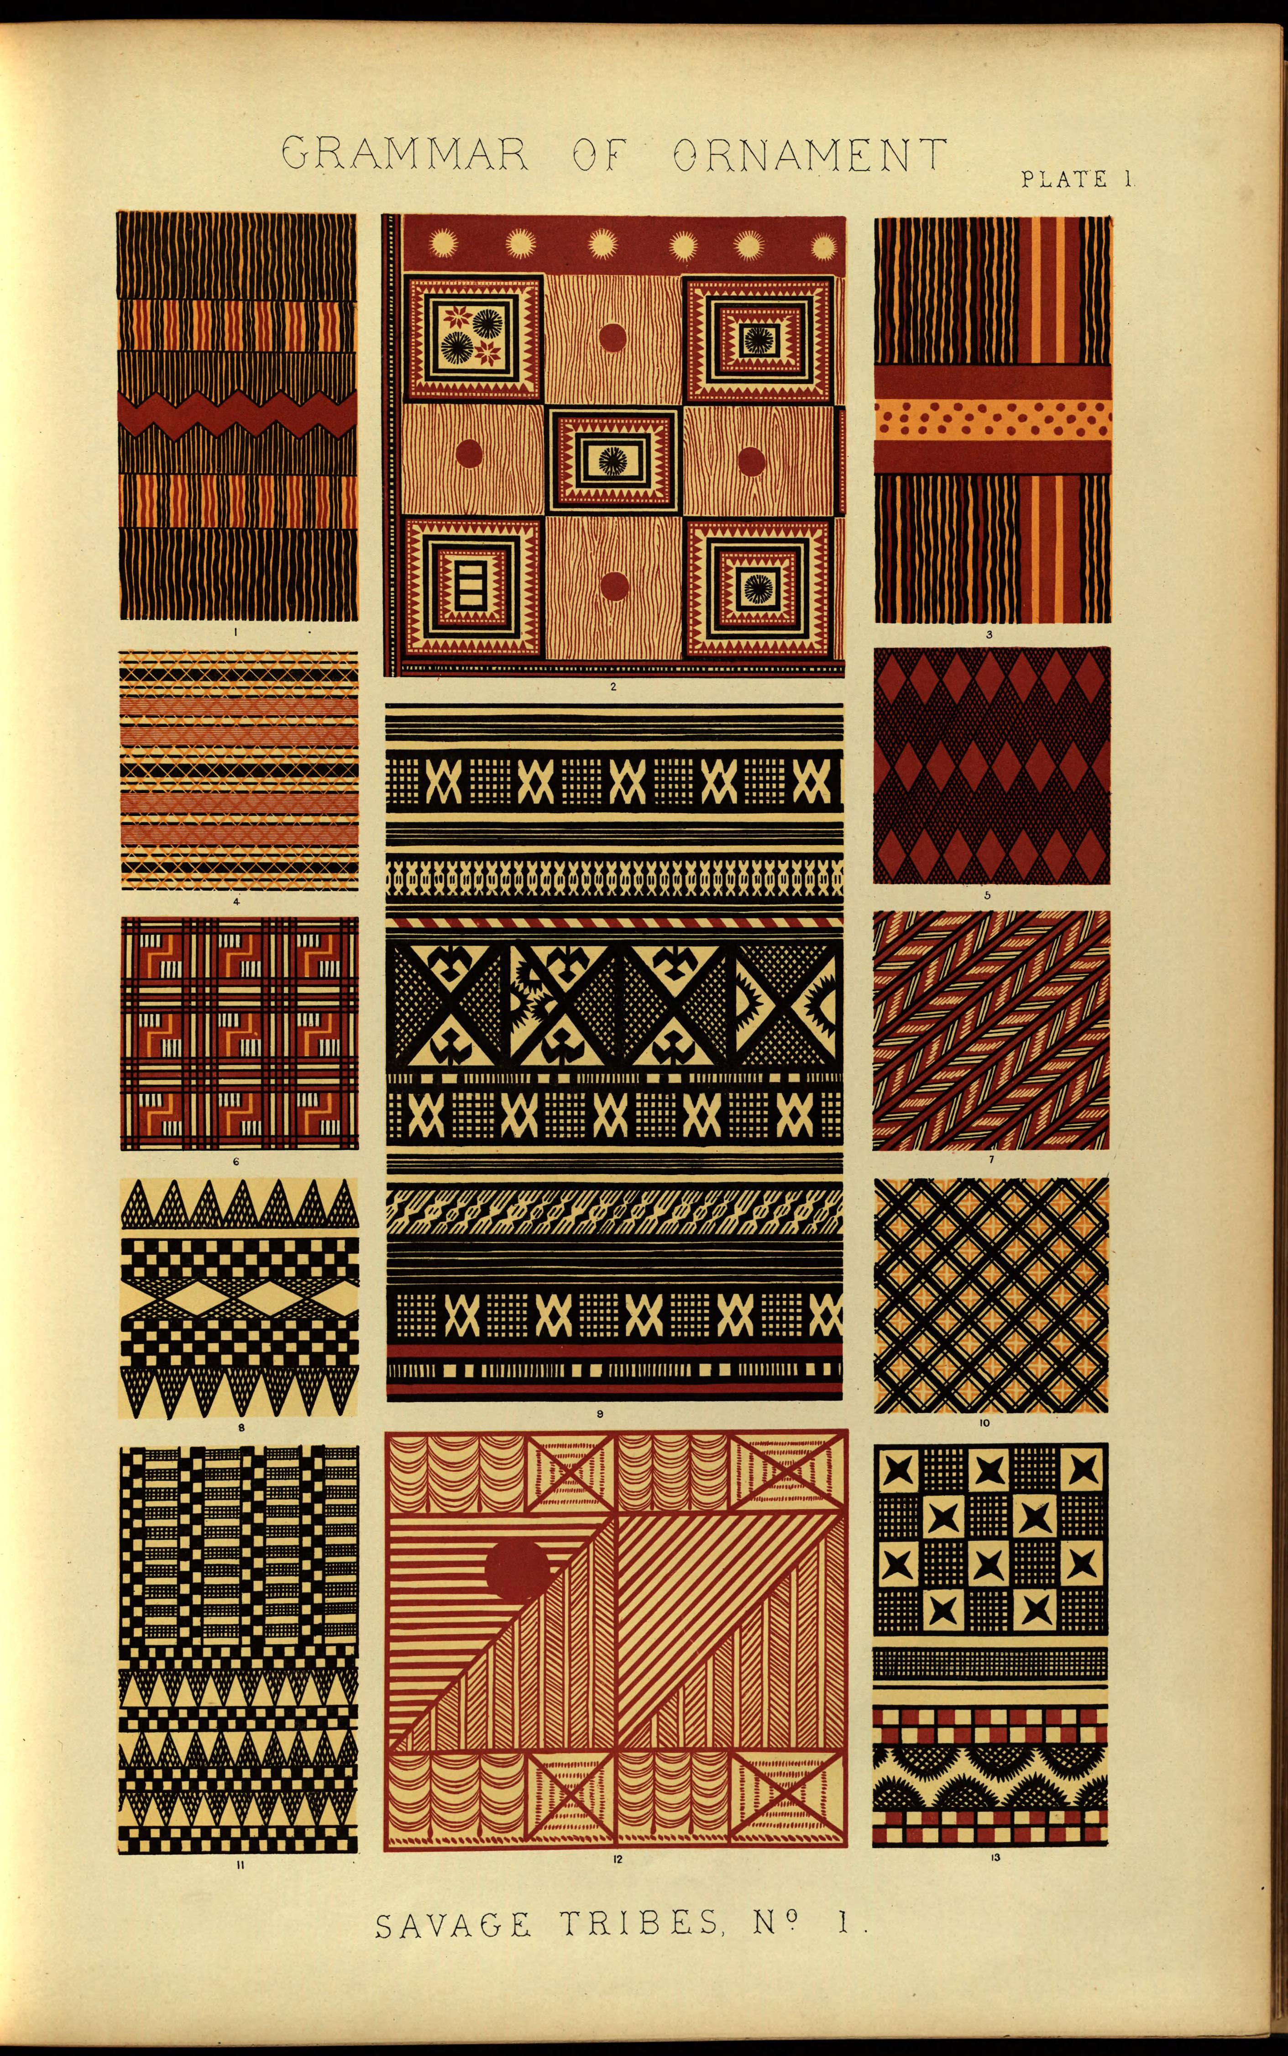
Plate from Owen Jones, The Grammar of Ornament, 1856
Notes:
original text information: Owen Jones, The Grammar of Ornament: London: Day and Son, 1856, Plate I.
my image source: online from digital library of Smithsonian Libraries here: http://library.si.edu/digital-library/book/grammarornament00jone. According to information at this page, this work is not in copyright.

Slide 2
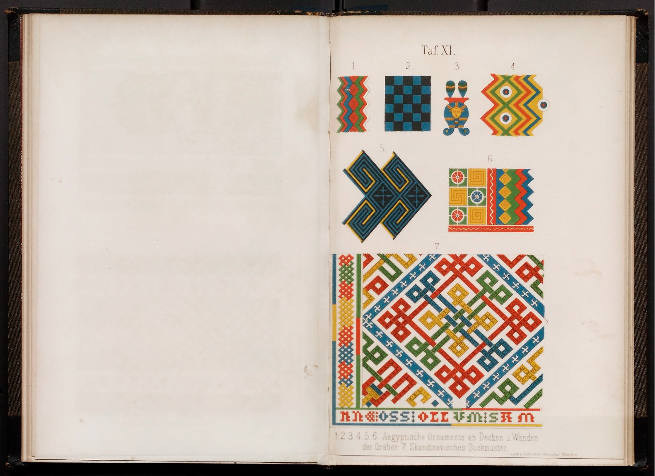
Plate from Gottfried Semper, Style in the Technical and Tectonic Arts; or, Practical Aesthetics, 1860–1863
Notes:
original text information: Gottfried Semper, Der Stil in den technischen und tektonischen Künsten, oder, Praktische Aesthetik : ein Handbuch für Techniker, Künstler und Kunstfreunde von Gottfried Semper. 2 vols. Frankfurt am Main: Verlag für Kunst & Wissenschaft, 1860; Munich: F. Bruckmann, 1863, Plate 11.
my image source: National Gallery of Art Library, Washington, D.C. Their copy: Gottfried Semper, Der Stil in den technischen und tektonischen Künsten, oder, Praktische Aesthetik : ein Handbuch für Techniker, Künstler und Kunstfreunde von Gottfried Semper, 2 vols., Munich: Druck v. Gebrüder Obpacher, 18--, Plate 11. This is the item in their online catalog: https://library.nga.gov/mercury/holdingsInfo?searchId=11&recPointer=1&recCount=20. You will see that the images are posted here online high quality.
This is probably not in copyright, but the NGA Library should be contacted about publication of this image: https://library.nga.gov/.

Slide 3
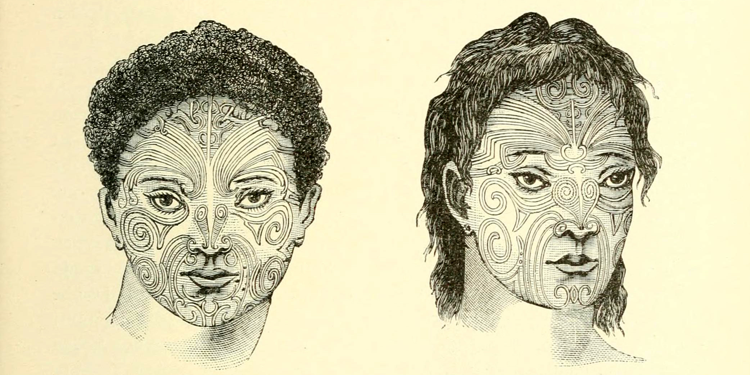
Illustration from Alois Riegl, Problems of Style: Foundations for a History of Ornament, 1893
Notes:
original text source: Alois Riegl, Stilfragen. Grundlegungen zu einer Geschichte der Ornamentik, Berlin: Georg Siemens, 1893, Figs. 31 and 32, pg. 79.
my source for the image: https://archive.org/details/stilfragengrundl00rieguoft. See library and copyright info. This text was scanned and uploaded by the University of Toronto Library, as it states on this page.

Slide 4
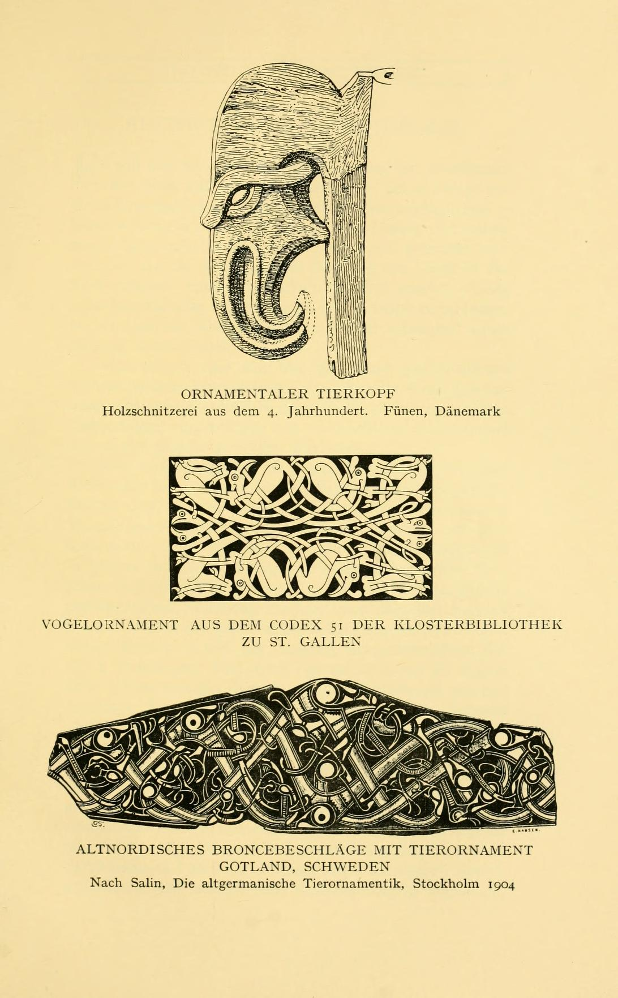
Illustration from Wilhelm Worringer, Form Problems of the Gothic, 1911
Notes:
original text source: Wilhelm Worringer, Formprobleme der Gotik, Munich: R. Piper & Co., 1912. 2nd edition. illustration between pages 4 and 5.
my image source : https://archive.org/details/formproblemederg00worruoft. Here it says that the book is not in copyright. This text was scanned and uploaded by the University of Toronto Library, as it states on this page

Slide 5
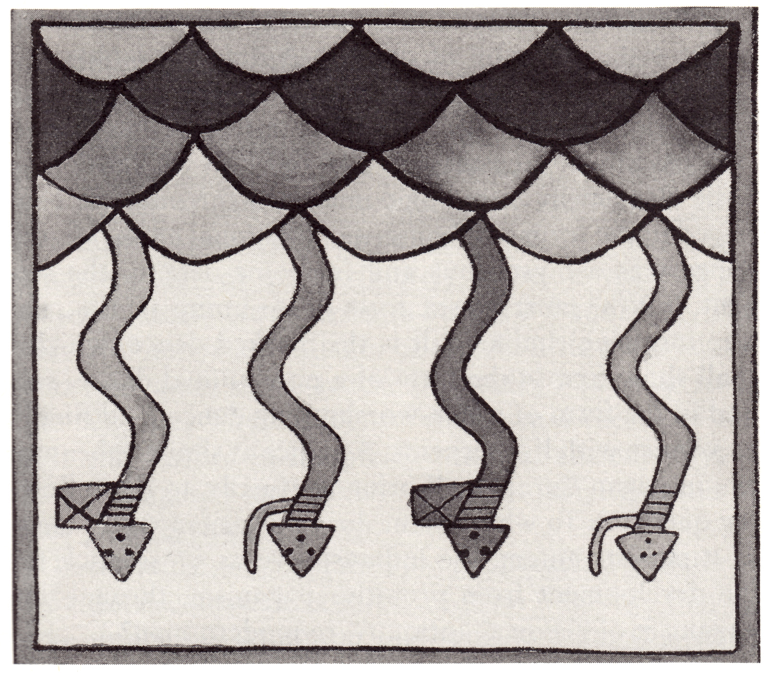
Illustration from Aby Warburg, ‘Images from the Region of the Pueblo Indians of North America,’ 1895–96/1923
Notes:
my image source: scan from: Aby Warburg, Images from the Region of the Pueblo Indians of North America, trans. Michael P. Steinberg, Ithaca, NY: Cornell University Press,1995, Fig. 1, p. 3.
The Warburg Archive at the Warburg Library can give permission to publish this or not. I have only seen images from this text used with permission of the Warburg Archive and Library. You can contact them here: http://warburg.sas.ac.uk/home/staff-contacts/archive/.
caption in Cornell U. book: Fig. 1. Serpent as lightning. Reproduction of an altar floor, kiva ornamentation."

Slide 6
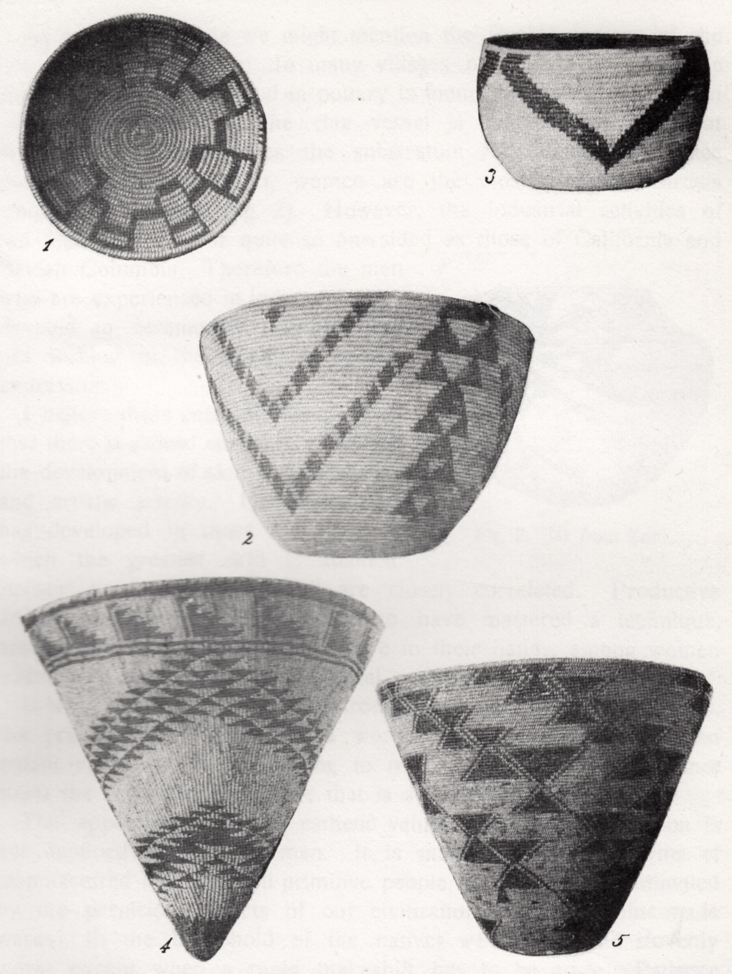
Illustration from Franz Boas, Primitive Art, 1927
Notes:
my image source: scanned from: Franz Boas, Primitive Art, New York, Dover Publications, 1955, Plate I (after page 18). Reprint of 1927 edition by H. Aschehoug & Co. Oslo.
This is probably not under copyright. It is available online here: https://archive.org/details/primitiveart00boas_im4
Caption under image in book: 'Maidu Baskets. 1–2 Butterfly design 3. Raccoon design 4. Rim: mountains; body: flying geese 5. Moth-miller.'

Slide 7
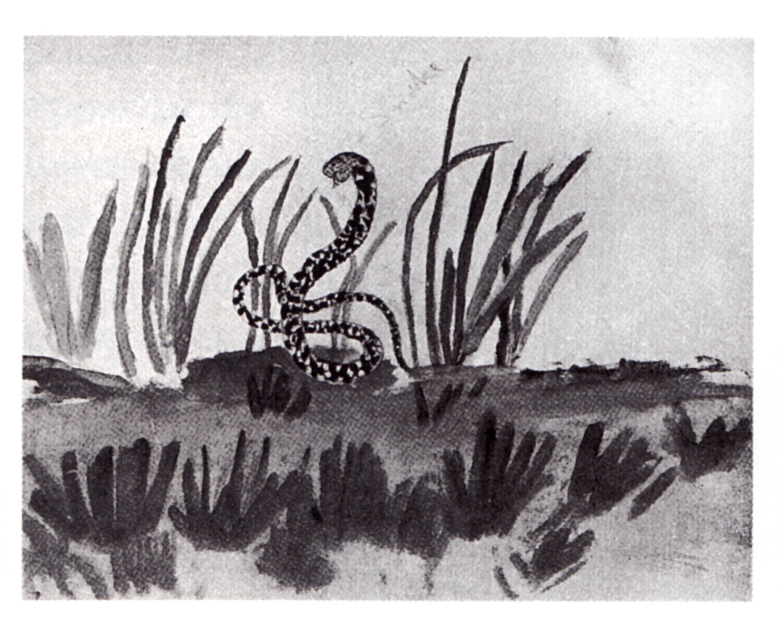
Illustration from Roger Fry, ‘Children’s Drawings,’ 1917
Notes:
original text source: Roger Fry, "Children's Drawings," Burlington Magazine 30 (June 1917), p. 227.
my image source: https://archive.org/details/burlingtonmagazi30londuoft. This text was scanned and uploaded by the University of Toronto Library, as it states on this page.
This is probably not under copyright, but I am not sure. It has been republished in the Roger Fry Reader and elsewhere.
caption under image in journal: '(D) "A Snake": By a Boy Aged 9'

Slide 8
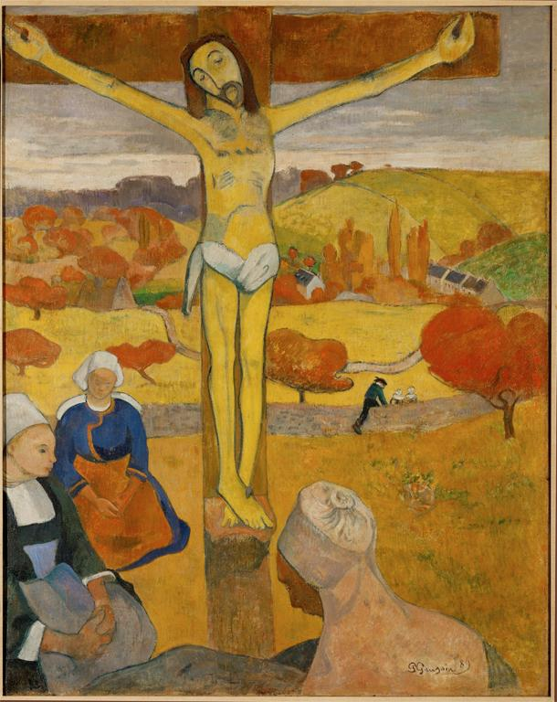
Paul Gauguin, Yellow Christ, 1889
Notes:
Creator: Paul Gauguin Title: Yellow Christ Date: 1889 Material: oil on canvas Measurements: 92 x 73 cm Repository: Albright-Knox Art Gallery Collection: Art, Archaeology and Architecture (Erich Lessing Culture and Fine Arts Archives) ID Number: 40-12-06/ 9 Source: Image and original data provided by Erich Lessing Culture and Fine Arts Archives/ART RESOURCE, N.Y. Source: http://www.artres.com/c/htm/Home.aspx Source: http://www.artres.com/c/htm/TreePfLight.aspx?ID=LES Rights: Photo Credit: Erich Lessing/ART RESOURCE, N.Y. Rights: Please note that if this image is under copyright, you may need to contact one or more copyright owners for any use that is not permitted under the ARTstor Terms and Conditions of Use or not otherwise permitted by law. While ARTstor tries to update contact information, it cannot guarantee that such information is always accurate. Determining whether those permissions are necessary, and obtaining such permissions, is your sole responsibility.

Slide 9
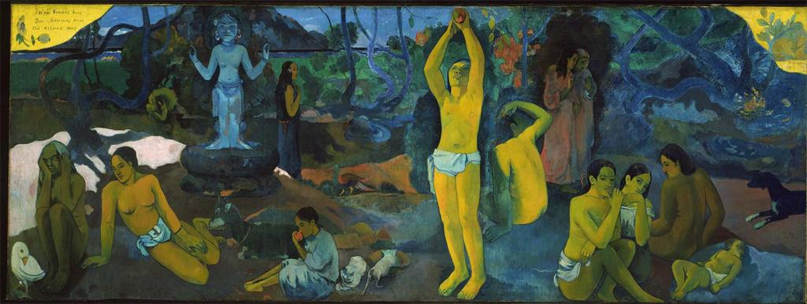
Paul Gauguin, Where Do We Come From? What Are We? Where Are We Going? 1897–98
Notes:
Creator: Paul Gauguin Creator: French, 1848-1903, European; French Title: Where Do We Come From? What Are We? Where Are We Going? Work Type: Paintings Date: 1897 Material: Oil on canvas Measurements: 139.1 x 374.6 cm (54 3/4 x 147 1/2 in.) Description: Full View Repository: Museum of Fine Arts, Boston Repository: Boston, Massachusetts, USA Repository: Tompkins Collection Repository: 36.270 Repository: http://www.mfa.org/ Collection: Museum of Fine Arts, Boston, Collection Collection: Formerly in The AMICO Library ID Number: BMFA.36.270 Source: Data From: Museum of Fine Arts, Boston Rights: This image was provided by Museum of Fine Arts, Boston. Contact information: Debra LaKind, Head of Rights & Licensing, Museum of Fine Arts, Boston, 465 Huntington Avenue, Boston, MA 02115, (617) 369-4386 (ph), (617) 369-4340 (fax), dlakind@mfa.org. Rights: Please note that if this image is under copyright, you may need to contact one or more copyright owners for any use that is not permitted under the ARTstor Terms and Conditions of Use or not otherwise permitted by law. While ARTstor tries to update contact information, it cannot guarantee that such information is always accurate. Determining whether those permissions are necessary, and obtaining such permissions, is your sole responsibility.

Slide 10
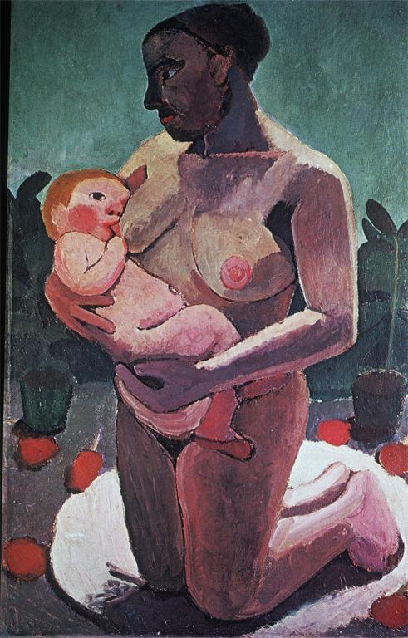
Paula Modersohn-Becker, Kneeling Mother with Child at her Breast, 1907
Notes:
Creator: Modersohn-Becker, Paula, 1876-1907 Title: Kneeling Mother & Child Date: 1907 Material: oil on canvas Measurements: 113x74cm Subject: Painting--Germany--20th C. A.D Collection: ARTstor Slide Gallery Source: Data from: University of California, San Diego

Slide 11
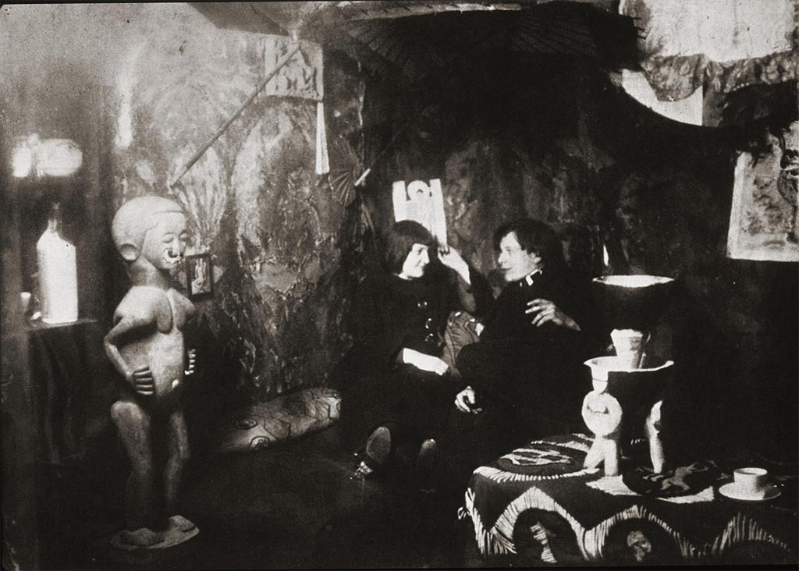
Photograph of Kirchner’s studio, 1912/1914, Berlin
Notes:
Creator: Kirchner, Ernst Ludwig, 1880-1938 Title: Photo: Artist w/Wife, Erna in Berlin Studio Subject: Painting--Germany--19th C. A.D Collection: ARTstor Slide Gallery Source: Data from: University of California, San Diego

Slide 12
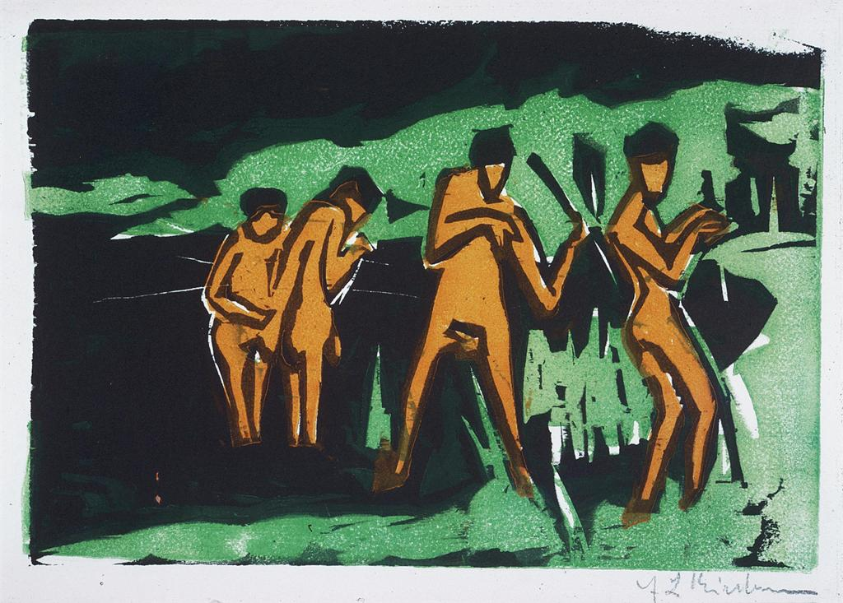
Ernst Ludwig Kirchner, Bathers Tossing Reeds, 1909, published 1910
Notes:
Creator: Kirchner, Ernst Ludwig, 1880-1938 Title: Bathers Tossing Roads Date: 1910 Material: color woodcut Measurements: h.20x29cm Subject: Prints--Germany--20th C. A.D Collection: ARTstor Slide Gallery Source: Data from: University of California, San Diego

Slide 13
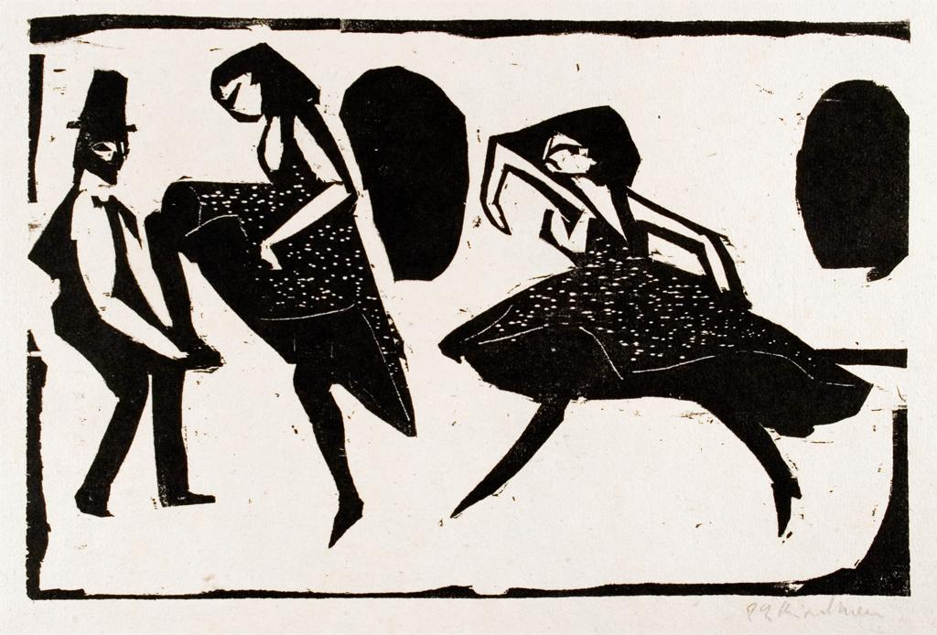
Ernst Ludwig Kirchner, Dancers (Acrobatic Dance), 1911
Notes:
Creator: Kirchner, Ernst Ludwig (German painter, printmaker, and sculptor, 1880-1938) Title: Dancers Akrobatischer Tanz Work Type: printmaking Date: 1911 Material: Woodcut Style Period: Expressionism Repository: Wriston Art Galleries, Lawrence University, Appleton, Wisconsin Repository: The La Vera Pohl Collection Accession Number: 82123 Subject: dancers, printmaking Collection: Wriston Art Center Galleries (Lawrence University) Collection: http://www.lawrence.edu/dept/wriston/ Rights: Contact information: Frank Lewis, Director and Curator, Wriston Art Gallery, 711 E. Boldt Way, Appleton, WI 54911; Tel: 920-832-6942; Fax: 920-832-7362; frank.c.lewis@lawrence.edu Rights: Please note that if this image is under copyright, you may need to contact one or more copyright owners for any use that is not permitted under the ARTstor Terms and Conditions of Use or not otherwise permitted by law. While ARTstor tries to update contact information, it cannot guarantee that such information is always accurate. Determining whether those permissions are necessary, and obtaining such permissions, is your sole responsibility.

Slide 14
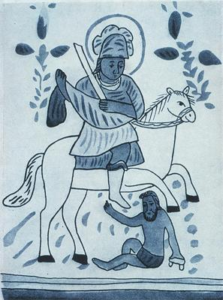
Frontispiece from the The Blue Rider, 1912 (Bavarian mirror painting, St. Martin)
Notes:
Creator
Title Der Blaue Reiter: St. Martin
Description From the magazine Der Blaue Reiter, 1912, published by Franz Marc and Wassily Kandinsky
Illustration of a Bavarian glass painting
Subject Martin, Saint, Bishop of Tours, ca. 316-397
Blaue Reiter (Group of artists)
Art Doc. Ref.--Germany--20th C. A.D
Kandinsky, Wassily, 1866-1944
Marc, Franz, 1880-1916
Collection ARTstor Slide Gallery
Source Data from: University of California, San Diego
Rights ? 2007 Artists Rights Society (ARS), New York / ADAGP, Paris
Download Size 400,400

Slide 15
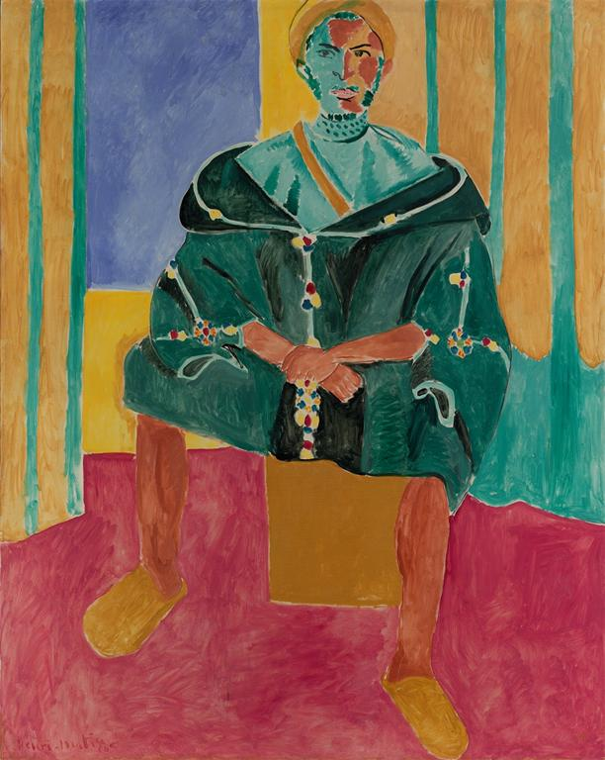
Henri Matisse, Seated Riffian, 1912
Notes:
Creator: Henri Matisse, 1869-1954 Title: Seated Riffian (Le rifain assis) Date: between November and December 1912 Material: Oil on canvas Measurements: 78 7/8 x 63 1/4 in. (200.3 x 160.7 cm) Repository: Barnes Foundation Accession Number: BF264 Collection: Barnes Foundation Collection: http://www.barnesfoundation.org/ ID Number: 6969 Rights: Image © 2010 The Barnes Foundation. All Rights Reserved. Rights: Contact information: Visual Resources Manager, The Barnes Foundation, 300 N. Latch's Lane, Merion, PA 19066; Phone: 610-667-0290 x1044; Fax: 610-664-4026; Email: rights@barnesfoundation.org Rights: Please note that if this image is under copyright, you may need to contact one or more copyright owners for any use that is not permitted under the ARTstor Terms and Conditions of Use or not otherwise permitted by law. While ARTstor tries to update contact information, it cannot guarantee that such information is always accurate. Determining whether those permissions are necessary, and obtaining such permissions, is your sole responsibility.

Slide 16
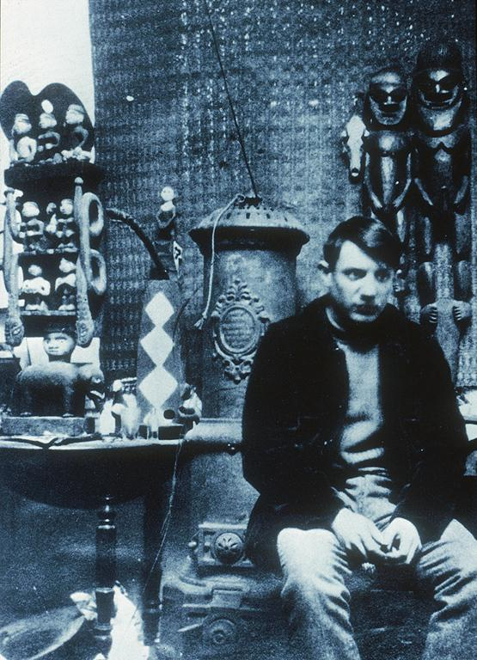
Photo of Pablo Picasso, 1908
Notes:
Creator: Picasso, Pablo, 1881-1973 Creator: Title: Photo: Picasso in his studio in in the Bateau-Lavoir, Paris Date: 1908 Subject: Picasso, Pablo, 1881-1973 Subject: Artists&apos; studios Subject: Painting--Spain--20th C. A.D Subject: Portraits--Artists Collection: ARTstor Slide Gallery Source: Data from: University of California, San Diego Rights: © Succession Picasso

Slide 17
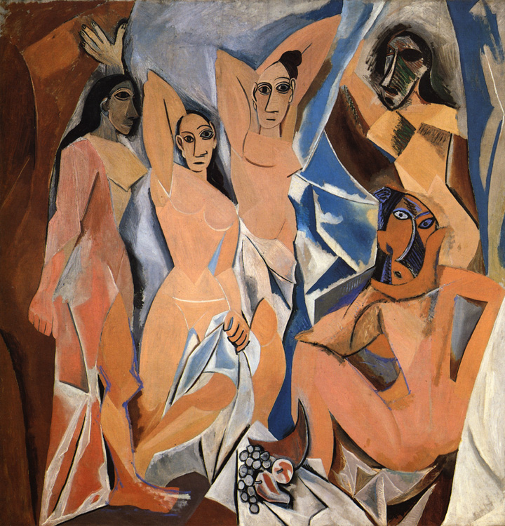
Pablo Picasso, Les Demoiselles d'Avignon, June-July 1907
Notes:
17
Not from ArtStor: further information:
Pablo Picasso. Les Demoiselles d'Avignon. 1907. Oil on canvas. 8' x 7' 8" (2.43 x 2.33 m). The Museum of Modern Art, New York. Acquired through the Lillie P. Bliss Bequest. (333.1939). © 2011 Estate of Pablo Picasso / Artists Rights Society (ARS), New York. [Fig. 19-07]
17

Slide 18
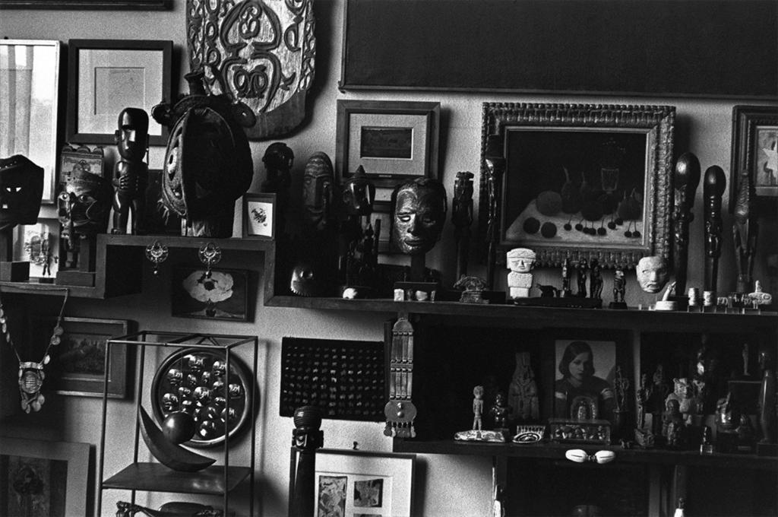
Henri Cartier-Bresson, photo of André Breton’s home, 1961
Notes:
Creator: Henri Cartier-Bresson Title: EUROPE. 1961. France. Paris. 18th arrondissement. Rue Pigalle. The French poet André BRETON's home. Date: 1961 Subject: PARIS Subject: France Collection: Magnum Photos ID Number: PAR88989.jpg Source: Image and original data provided by Magnum Photos Source: http://www.magnumphotos.com/ Rights: ©Henri Cartier-Bresson / Magnum Photos Rights: Contact information: Mark Lubell, Bureau Chief, Magnum Photos, 151 West 25th Street, New York, New York 10001-7204 Rights: Please note that if this image is under copyright, you may need to contact one or more copyright owners for any use that is not permitted under the ARTstor Terms and Conditions of Use or not otherwise permitted by law. While ARTstor tries to update contact information, it cannot guarantee that such information is always accurate. Determining whether those permissions are necessary, and obtaining such permissions, is your sole responsibility.

Slide 19
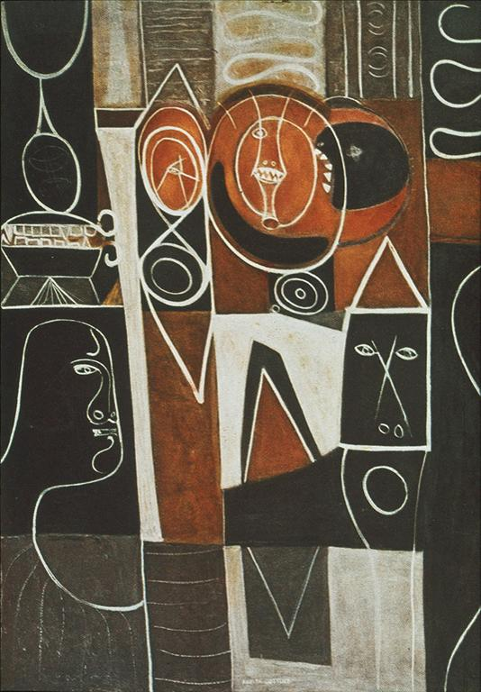
Adolph Gottlieb, Alkahest of Paracelsus, 1945
Notes:
Creator: Gottlieb, Adolph, 1903-1974 Title: Alkahest of Paracelsus Date: 1945 Material: oil on canvas Measurements: 60x44' Subject: Painting--United States--20th C. A.D Collection: ARTstor Slide Gallery Source: Data from: University of California, San Diego Rights: Art (c) Adolph and Esther Gottlieb Foundation / Licensed by VAGA, New York, NY. Rights: This work of art is protected by copyright and/or related rights and may not be reproduced in any manner, except as permitted under the ARTstor Digital Library Terms and Conditions of Use, without the prior express written authorization of VAGA, 350 Fifth Avenue, Suite 2820, New York, NY 10118. Tel.: 212-736-6666, fax: 212-736-6767, email: info@vagarights.com.

